Slide 1
Chapter 3
3-phase Induction Motors

Slide 2
Introduction
The polyphase induction motor is the most widely used motor in industrial and commercial applications.
There are two types, namely slip ring induction motor and squirrel-cage induction motor.
The squirrel-cage is more common because of its low-cost, high reliability and high efficiency over a wide range of power outputs.

Slide 3
Introduction cont’d
From a constant frequency source, the squirrel-cage motor operates as a constant speed drive.
For continuous speed control over a wide speed range, it is supplied from a solid-state variable-frequency converter.

Slide 4
Construction
A three-phase induction motor has two main parts:
a stationary stator and
a revolving rotor.
The rotor is separated from the stator by a small air-gap which ranges from 0.4 mm to 4 mm depending on the power rating of the motor.

Slide 5
Stator
It consists of a steel frame which encloses a hollow, cylindrical core made up of stacked laminations.
A number of slots are punched uniformly round the gap surface of the core.
These slots carry the stator 3-phase winding.

Slide 6
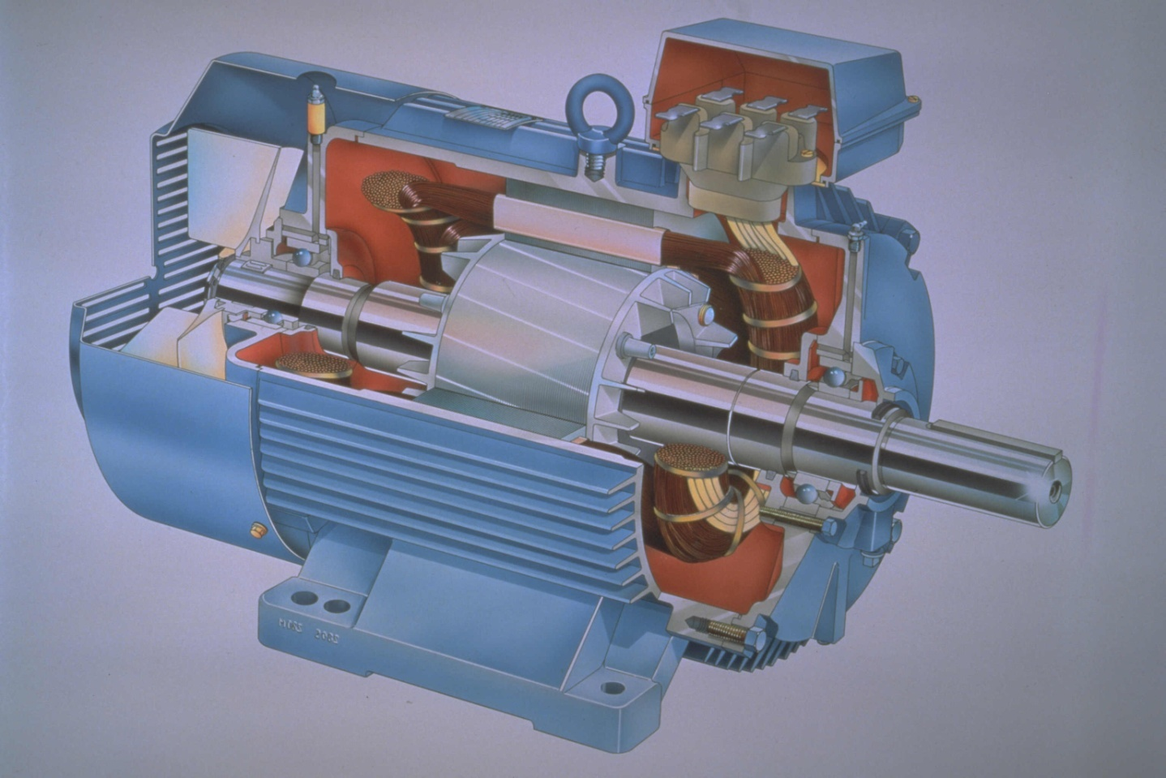
Induction Motors

Slide 7
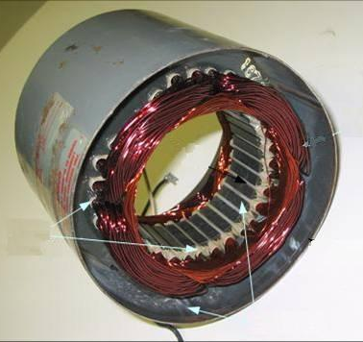
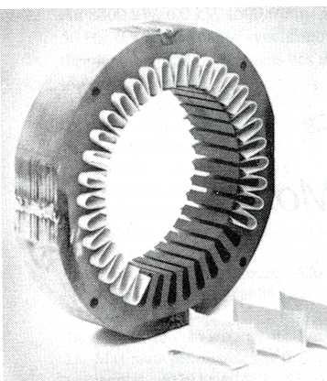
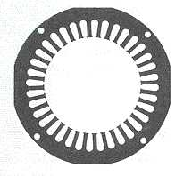
Core laminations
Carries the stator windings
Made of silicon steel 0.3 to 0.5mm thick
Insulated from one another to reduce eddy current loss

Slide 8
Rotor
It is also composed of punched laminations.
These are carefully stacked to create a series of rotor slots to provide space for the rotor winding.
Two types of rotor windings are used.
The type of winding gives rise to two main classes of motors:
  squirrel-cage induction motors and
  wound-rotor or slip-ring induction motors.

Slide 9
Squirrel-cage rotor
Bare copper bars, slightly longer than the rotor are pushed into the slots.
The opposite ends are welded to two copper end-rings, so that all bars are short-circuited together.
In small (10 kW or less) and medium-size motors (between 10 kW and 1000 kW), the bars and end-rings are made of die-cast aluminium moulded together to form an integral block.

Slide 10
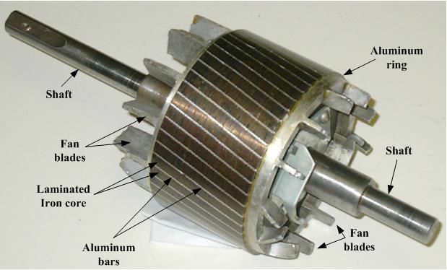

Slide 11
Wound or slip-ring rotor
The slots carry three-phase winding similar to the one on the stator.
The windings are usually connected in star.
The terminals are connected to three-slip rings which turn with the rotor.

Slide 12
Wound or slip-ring rotor cont’d
The revolving slip-rings and associated stationary brushes enable us to connect external resistors in series with the rotor windings.
The rotor of an induction motor could be wound for a number of phases different from that for the stator.

Slide 13
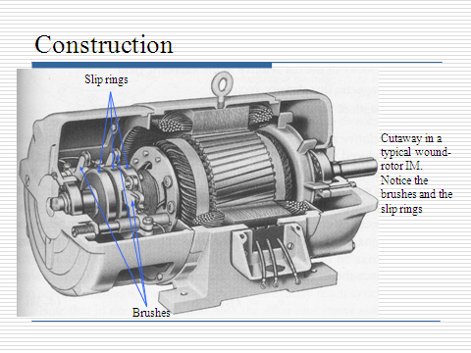

Slide 14
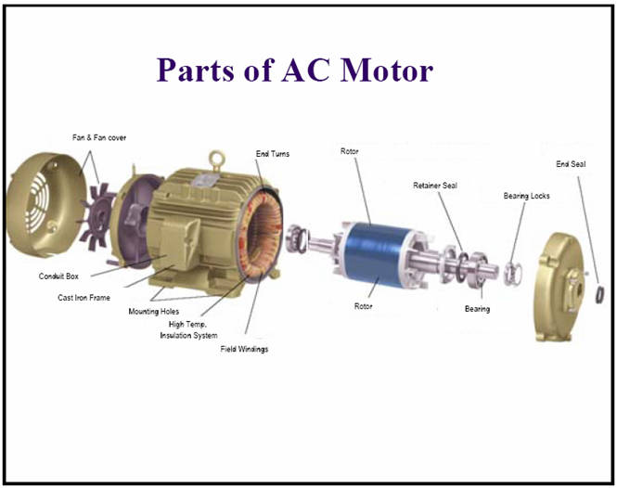

Slide 15
Principle of operation of the
induction motor
A rotating magnetic field is set up when a 3-phase voltage is applied to the stator of an induction motor.
The rotating field cuts across the rotor conductors and induces a voltage in all of them.

Slide 16
The induced voltage causes large currents to flow in the conductors and these interact with the magnetic field to produce a torque which, according to Lenz’s law, drags the rotor along in the direction of the revolving field
According to Lenz’s law, the induced voltage in the rotor will tend to set up a current whose magnetic field will oppose the motion or change of flux responsible for inducing the voltage.

Slide 17
Acceleration of the rotor - slip
As the motor picks up speed, the relative velocity of the field with respect to the rotor diminishes progressively.
This causes both the value and the frequency of the rotor induced voltage to decrease because the rotor conductors are cut more slowly.
The rotor current, very large at first, decreases rapidly as the motor picks up speed.

Slide 18
Acceleration of the rotor – slip cont’d.
The speed will continue to increase, but it will never catch up with the rotating field.
In effect, if the rotor did turn at the same speed as the field, the field would no longer cut the rotor conductors and the induced voltage and current would fall to zero.
Under these conditions, the force acting on the rotor conductors would also become zero and friction and windage would immediately cause the rotor to slow down.

Slide 19
Acceleration of the rotor – slip cont’d.
The rotor speed must always be slightly less than synchronous speed (i.e. the speed of the revolving field) so as to produce a current in the rotor bars sufficiently large to overcome the braking torque.
At no load the difference in speed between the rotor and field (called slip) is very small, usually less than 0.1 % of synchronous speed.

Slide 20
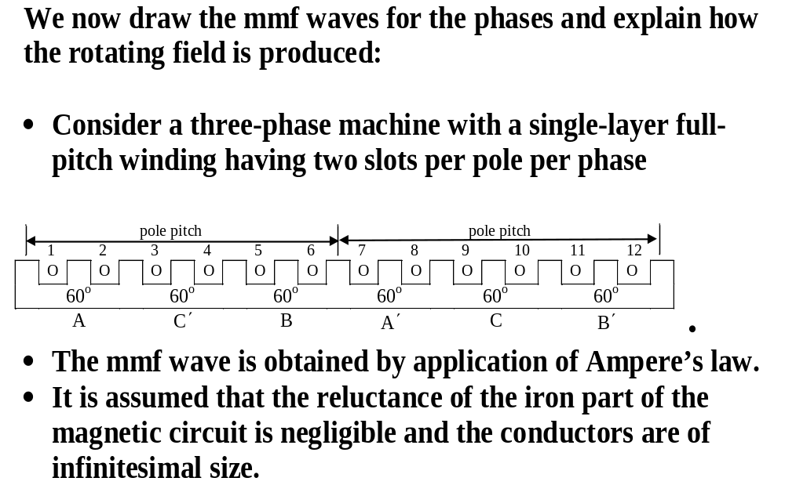
Production of rotating field by 3-phase
currents in 3-phase winding

Slide 21
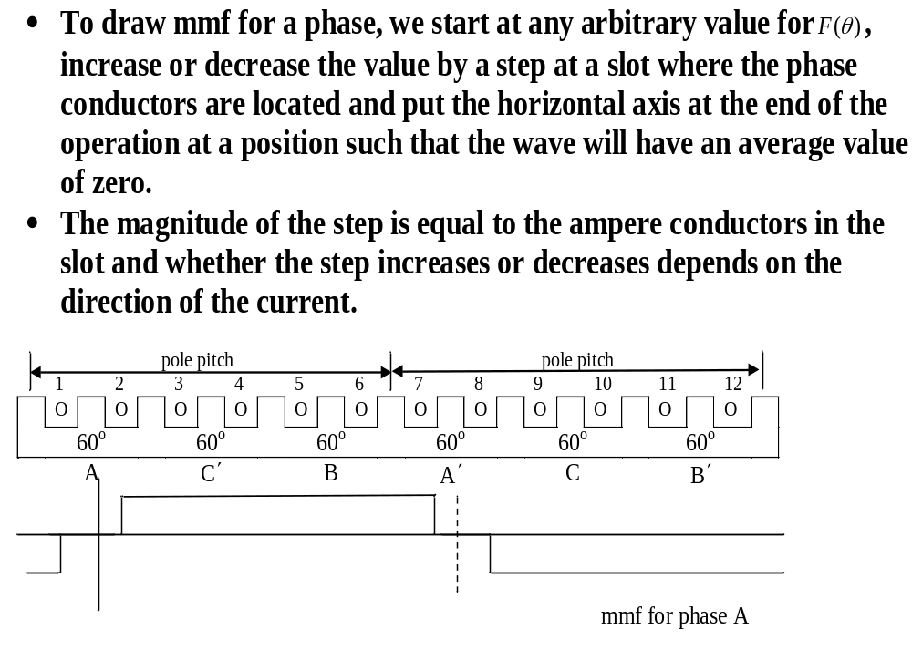

Slide 22
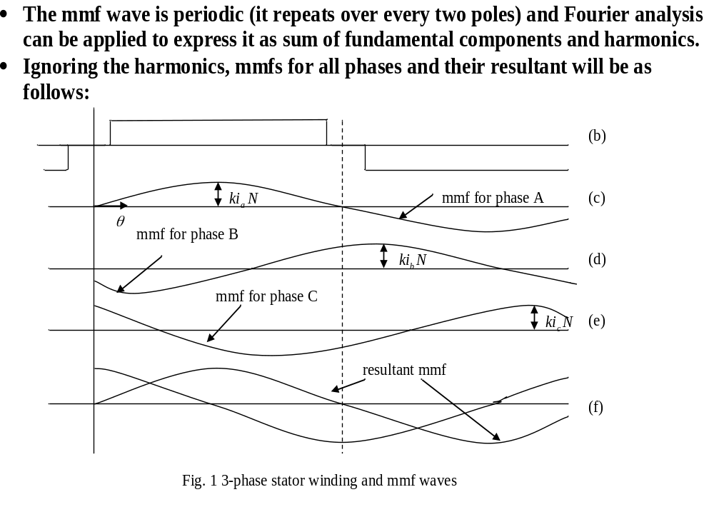

Slide 23
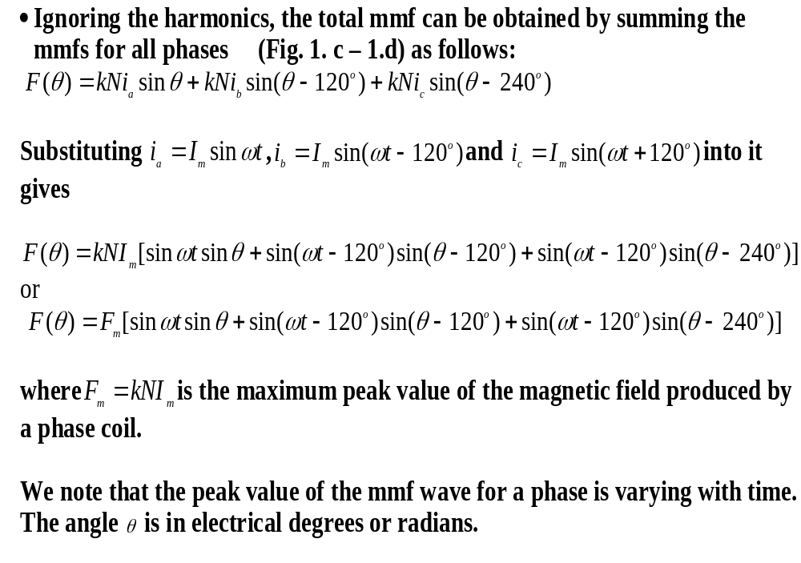

Slide 24
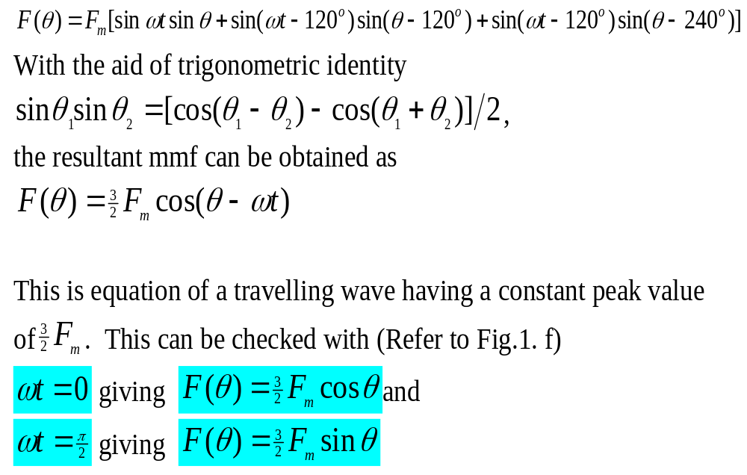

Slide 25
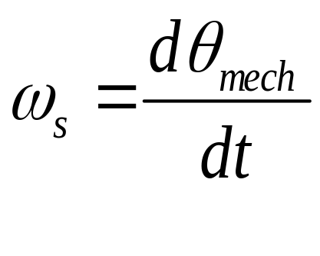
Speed of mmf wave
The speed of the wave is obtained by equating the argument of the cosine to a constant and differentiating with respect to time. Thus for a 2p-pole machine, the speed of rotation
called synchronous speed is given by

Slide 26
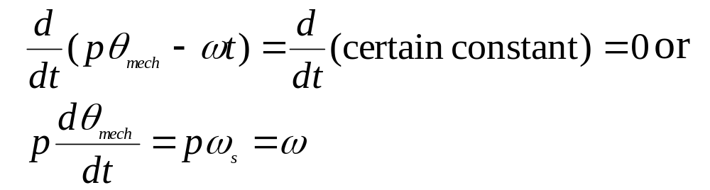
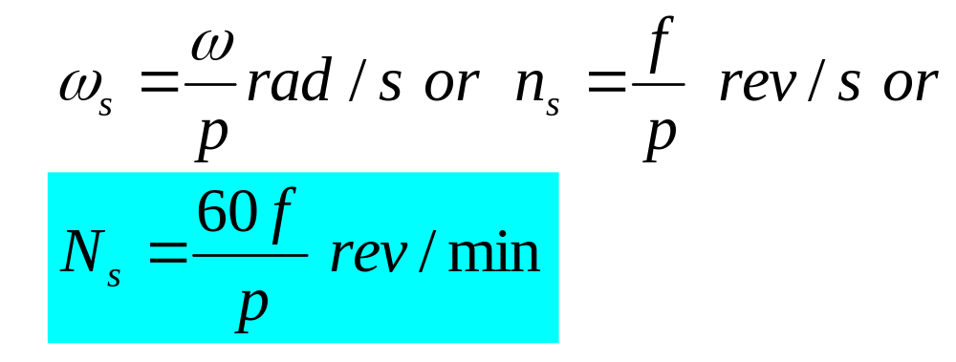
Speed of mmf wave cont’d
Therefore

Slide 27
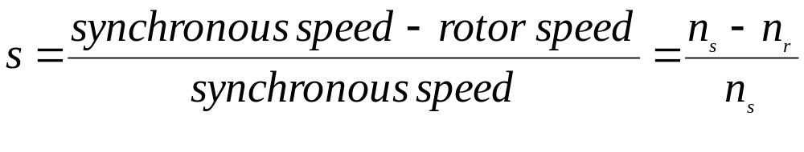
Definition of slip
The slip, s of an induction motor is defined as
s =1 when the rotor is locked or at standstill.
On no load s is usually less than 0.001 and at full load s is usually less than 0.005 for large motors (1000 kW and more) and less than 0.03 for small motors (10 kW or less).
For this reason induction motors are considered to be constant speed machines.

Slide 28
Rotor frequency
The frequency of the voltage induced in the rotor depends upon the slip.
It is given by
f_{r} = sf (3)
where f = frequency of the source connected to the stator.

Slide 29
